Slide 1
Linqpad

Slide 2
What is Linqpad?
Linqpad is…
A dotnet sandbox/playground
A dotnet scripting tool
A dotnet learning tool
A lot of fun!

Slide 3
Linqpad Features
Instantly test any C#/F#/VB snippet or program
Query databases in LINQ (or SQL) — SQL/Azure, Oracle, SQLite, Postgres & MySQL
Enjoy rich output formatting, optional autocompletion and integrated debugging
Script and automate in your favorite .NET language
Super lightweight — single 20MB executable!
Standard edition free, with no expiry

Slide 4
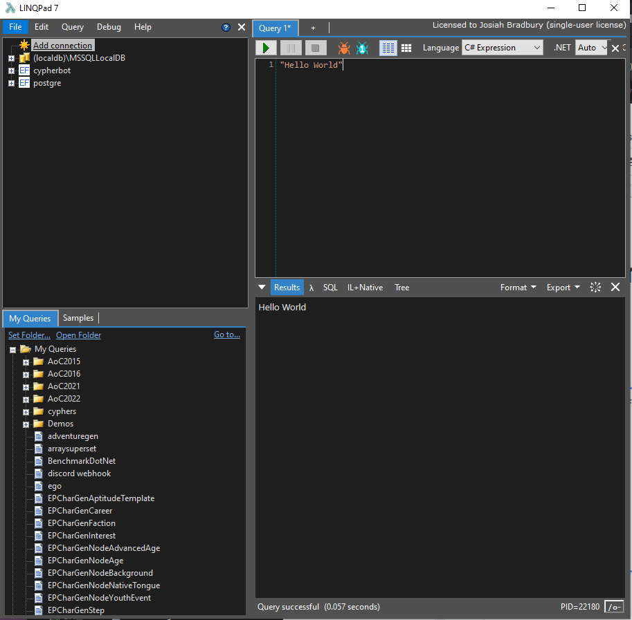
Linqpad: A tour
The four main components
The Connections window
The Code window
The Results window
The query/sample window

Slide 5

Demos

